Slide 1
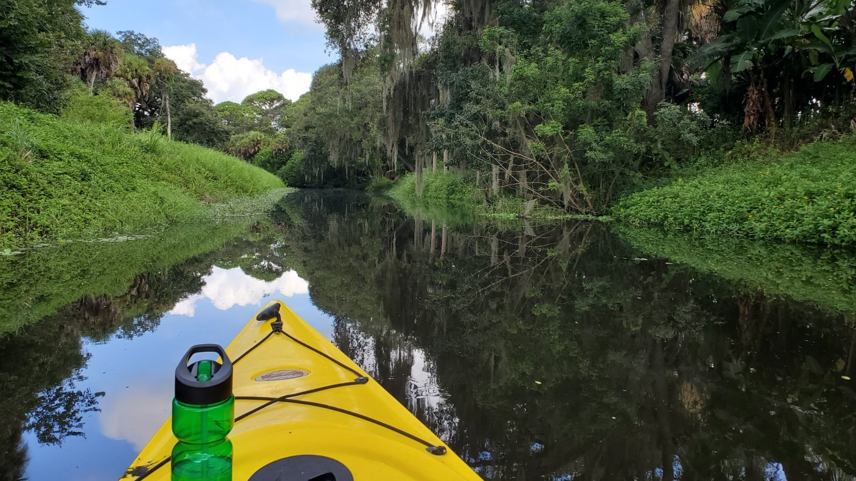


Alligator Creek Stream Restoration

Slide 2
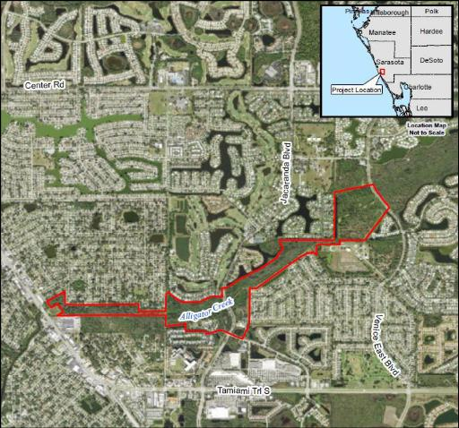
Alligator Creek Stream Restoration
Background
Tidally influenced creek beginning as a freshwater wetland system flowing to Lemon Bay
Urbanized watershed
Alterations to system began in 1940’s
Excavated to typical trapezoidal cross-section in project area
Notes:
Alligator Creek is in the southern portion of Sarasota County and flows to Lemon Bay, which is an Outstanding Florida Water.
Alligator Creek begins upstream as a freshwater wetland system. As it travels downstream it transitions into a tidally influenced creek. Now what is special is it makes this transition in approximately two miles. This offers both design challenges and opportunities.
Now what is not unique about Alligator Creek, as compared to other streams in Florida in urbanized areas, is it has been significantly altered. Historically, Alligator Creek was hydrologically connected to the adjacent landscape but in the 1940s, hydrologic alterations took place eliminating connection to the historic floodplain and adjacent wetlands.
Additionally, the creek has been over-excavated to a typical trapezoidal cross-section to increase conveyance and capacity.

Slide 3
Alligator Creek Stream Restoration
Project Overview
Why Alligator Creek?
  Steep and unstable side banks resulting in excessive erosion and sedimentation
  High nutrient loading due to increased drainage flow
  Nuisance/Exotic vegetation overtaken native stream and shoreline habitats
  Ditching has resulted in significant waterbody degradation and homogenization, diminishing important fish rearing habitat and biodiversity
Notes:
There are several reasons why Sarasota County chose to restore this stream.
First, the unstable, steep side banks require frequent maintenance to deal with excessive erosion. I will be honest historic maintenance practices (vegetation scalping) have not helped the situation either.
Secondly, the increased movement of water through an enlarged cross section delivers an unnaturally large load of nutrients to the creek and downstream to Lemon Bay. Alligator Creek has been subject to Total Maximum Daily Load (TMDL) for nutrients since 2006. This TMDL calls for a 28% reduction in total nitrogen. Additionally, Lemon Bay is currently impaired for nutrients, bacteria, and chlorophyll-a.
This system also has significant nuisance and exotic vegetation along the stream corridor and adjacent landscape resulting in degradation of the adjoining habitats.
Lastly, not only does the erosion result in sedimentation that can hinder flow, but this excess sediment, especially in combination with the ditching of the channel, negatively impacts important benthic and fisheries habitat.

Slide 4
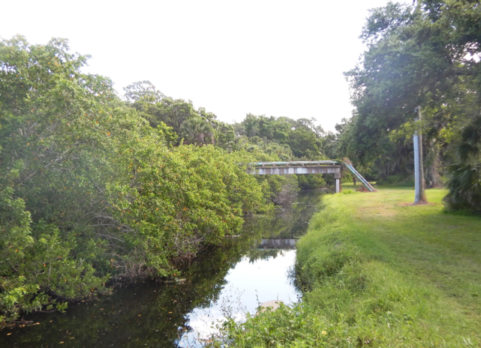
Alligator Creek Stream Restoration
Project Benefits
Remove nutrients
Stabilize banks
Reduce maintenance
Improve fisheries habitat
Improve resiliency
Enhance recreational area
Notes:
The stream is significantly altered, but it is not beyond restoration.
With the restoration we are planning to …….. Remove nutrients, stabilize banks, reduce maintenance, improve fisheries habitat, improve resiliency, and enhance recreational area. Certainly, the list doesn’t stop there but these are the most significant benefits.
Here to talk about the design and how the design will provide these benefits is our consultant John Kiefer with Wood Environmental.

Slide 5
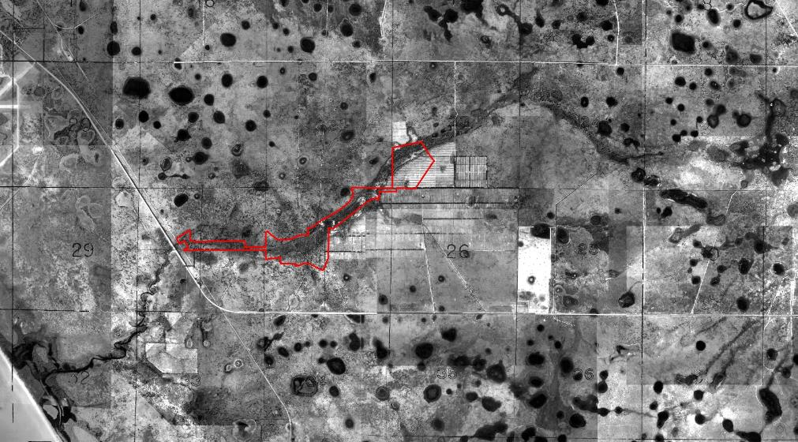
1948
Chain of Strands (freshwater)
Upper Tidal
(transition)
Tidal Creek
(estuarine)
Notes:
Predevelopment valley was freshwater under variable alluvial control. The system consisted of a chain-of-strands several feet above the intertidal zone.

Slide 6
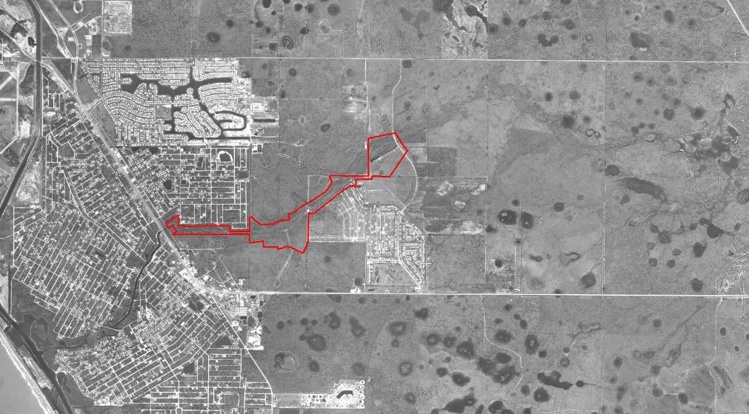
1974
Upper Tidal Ditch
(transition)
Chain of Strands (freshwater)
Tidal Ditch
(estuarine)
Notes:
Show 40s vs 70s aerials, zoomed out far to the original tidal boundary. Talk about dewatering, and how Priority 2 in the tide is needed to prevent flooding – so the tidal creek has shifted inland.

Slide 7
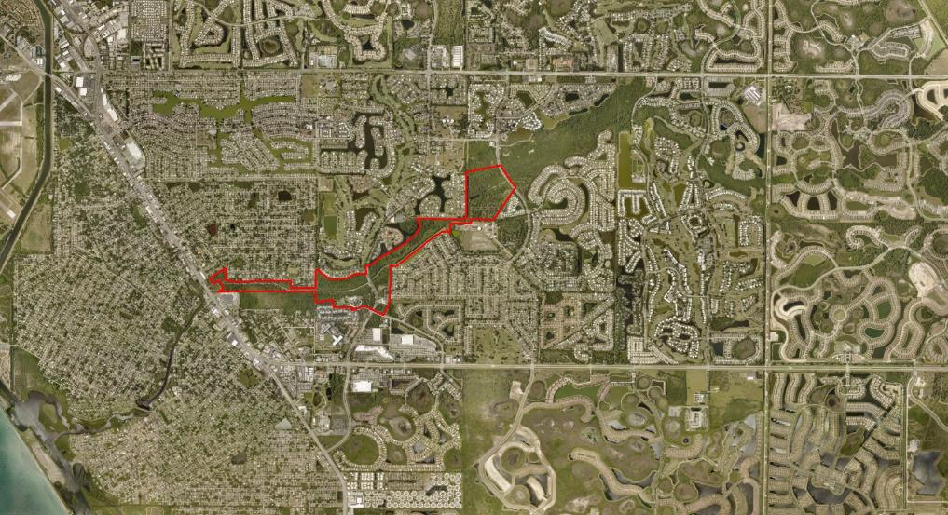
2019
Upper Tidal Ditch
(transition)
Strands/Ponds (freshwater)
Lake Liesl Drop Structure
Tidal Ditch
(estuarine)
Notes:
Show 40s vs 70s aerials, zoomed out far to the original tidal boundary. Talk about dewatering, and how Priority 2 in the tide is needed to prevent flooding – so the tidal creek has shifted inland.

Slide 8
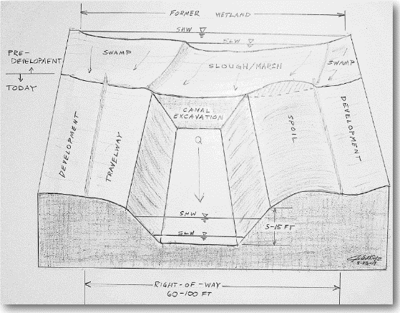
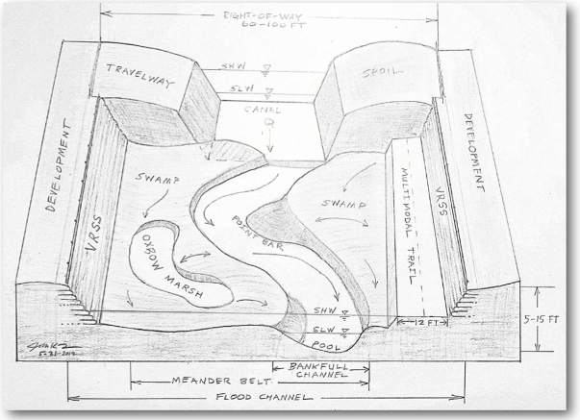
The Altered Drainage Network
Priority 2 Restoration
Notes:
Replace with Phillippi impact oblique diagram

Slide 9
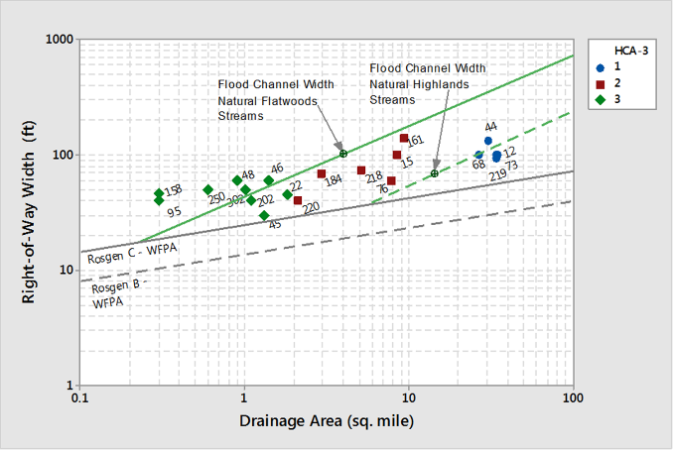
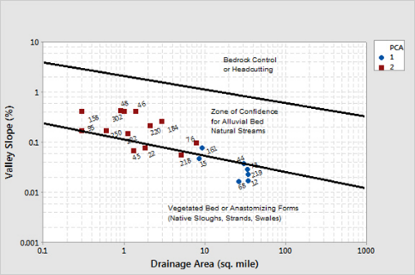
Florida’s Biophysical Fit
Harness natural forces and use nature as our guide
  More resilient
  Less maintenance
  More beautiful
  Efficient design and construction
Surface water and groundwater gradients
Low relief and deranged drainage networks
Tide
Salinity
Notes:
Bankfull channel: Wet season flood channel: floodpulse.

Slide 10
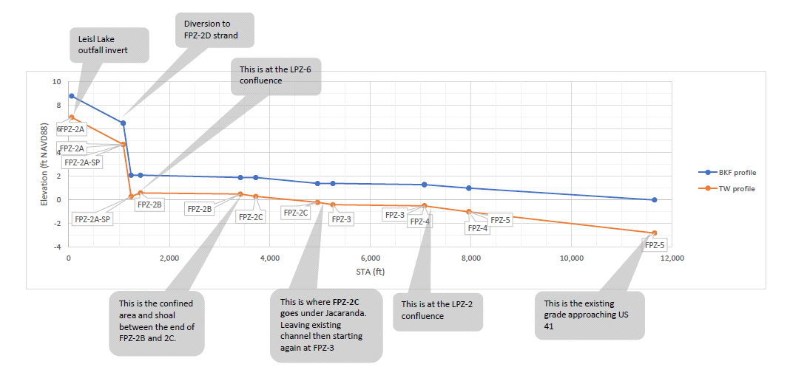
MHT ~1.1
MLT ~-0.3
Notes:
Profile is iterative – built from the bottom up from persistent shoals, bridges, and key confluences with lateral canals. The active alluvila floodplain is then benched at elevations set by regional curve depths. Everything is vetted for no-rise flood effects using watershed H&H models like ICPR or SWMM.

Slide 11
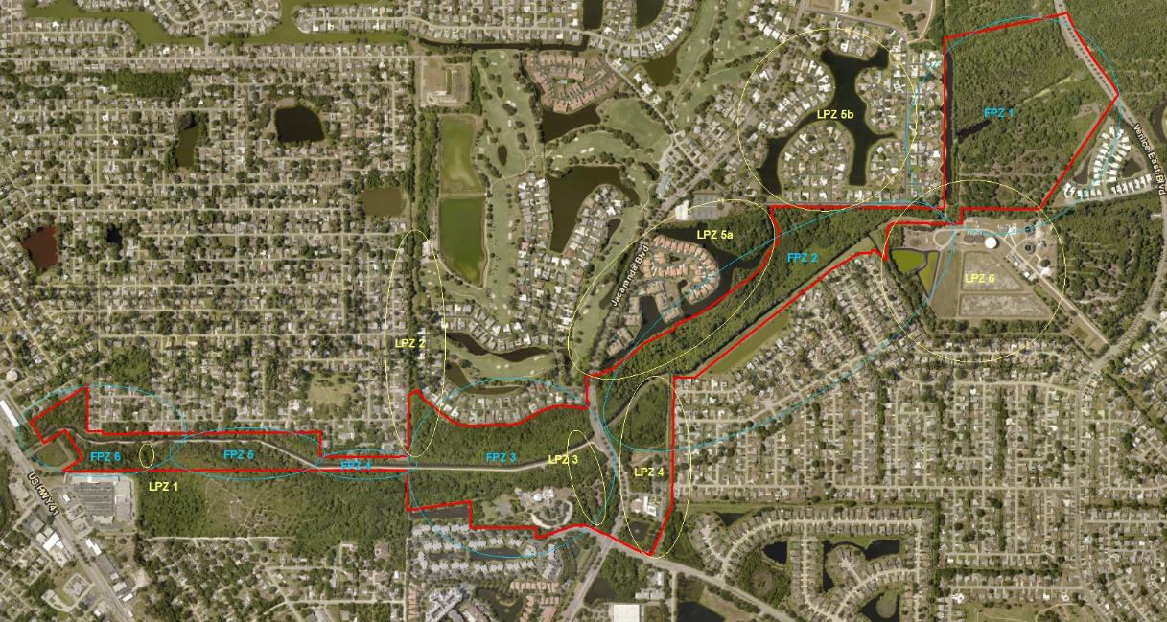
Functional Process Zones
Notes:
The existing conditions and project objectives require a combination of natural and novel functional process zones along the valley – natural strands, native alluvial headwater creeks – non-native step-pools designed for upstream juvenile snook passage – two-stage channels designed as juvenile tarpon and snook rearing areas – natural analog upper tidal creek with mangrove fringe swamps.The homogenized site has tremendous geodiversity/biodiversity potential. And the reach of the work extends benefits beyond its boundaries…

Slide 12
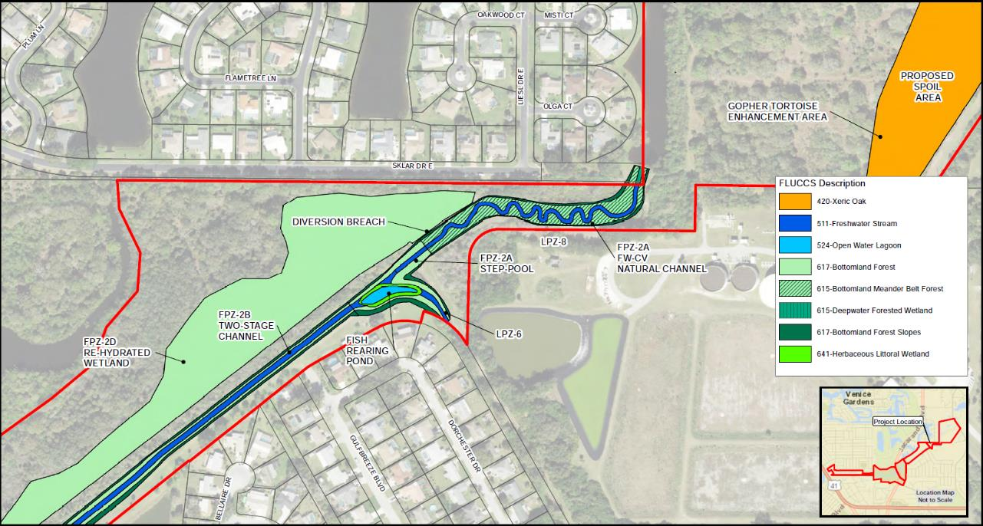
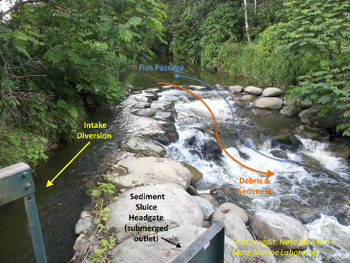

Slide 13
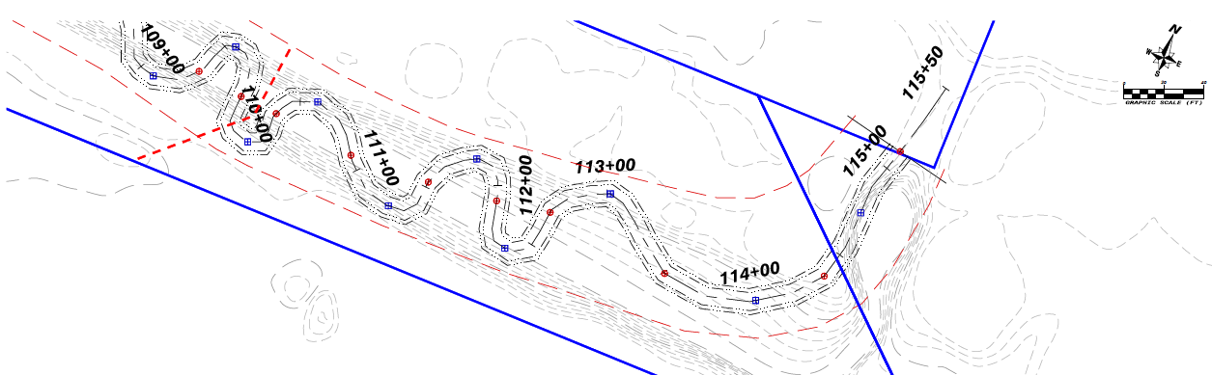
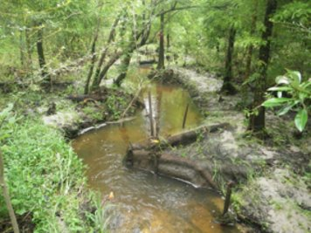
Notes:
Freshwater mid-order creek – minor tidal influence.

Slide 14
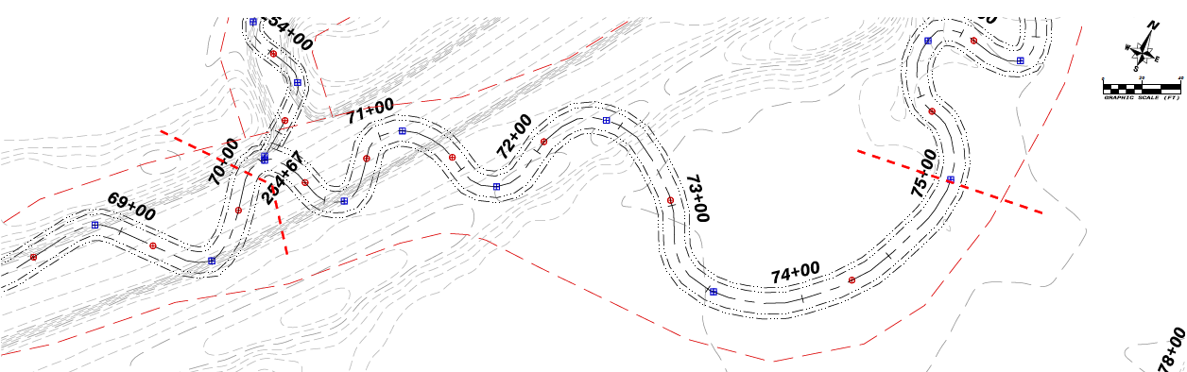
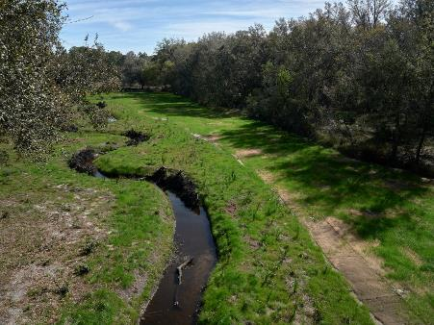
Notes:
Freshwater mid-order creek – minor tidal influence.

Slide 15
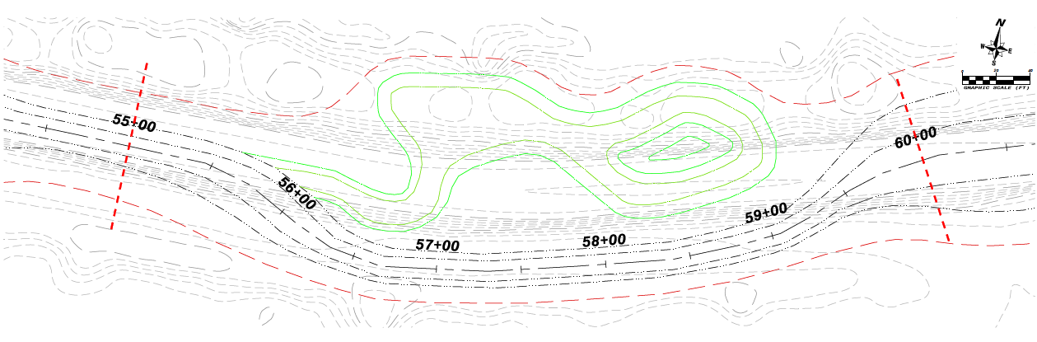
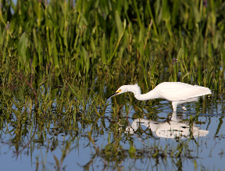
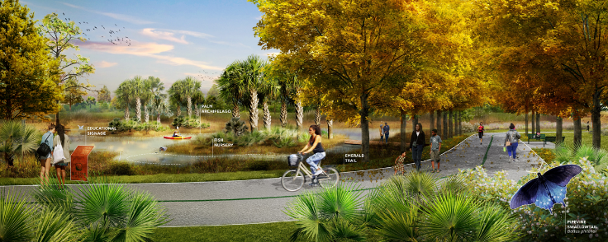
Rendering by SCAPE for Wood.

Slide 16
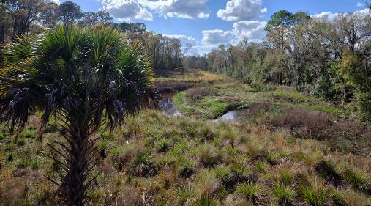
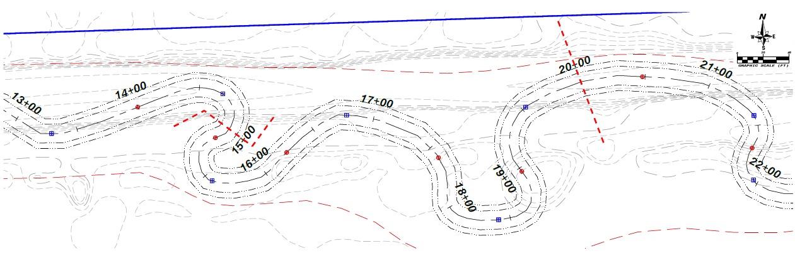
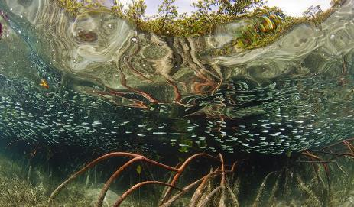
Notes:
Tidal channel has pattern and dimension ore similar to 30 sm freshwater channel than that of the 7 sm area this FPZ drains.

Slide 17
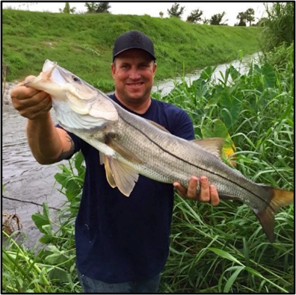
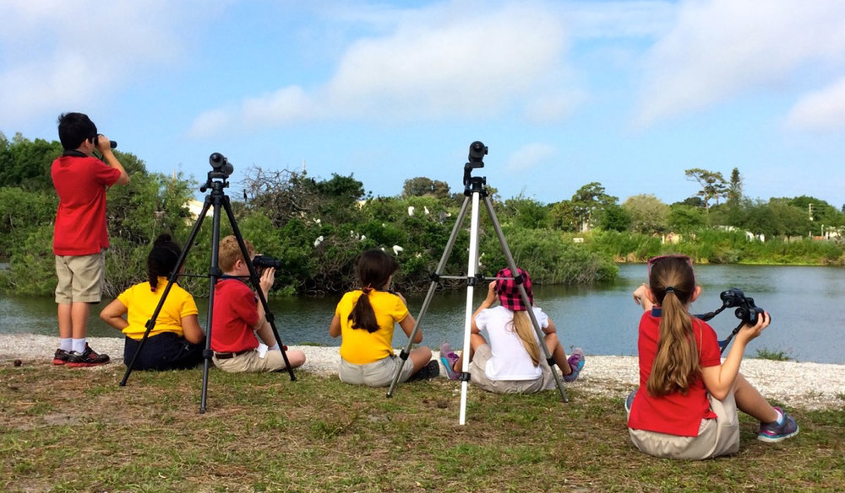
World Famous Venice Rookery
(at Venice Area Audubon Rookery)
from Nate Brennan, Mote Marine Laboratory
Venice Snookery (coming soon to Alligator Creek)
Second grade students on a field trip to the Venice Area Audubon Rookery
By Lynne Pedlar
Notes:
Create an urban ecology and cohesive and enriching recreation experience. Venice rookery is less than ¾ mile south of the Creek – as the egret flies.

Slide 18
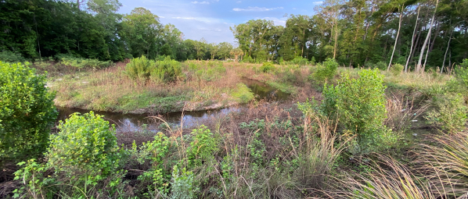
A Biologically Diverse & Beautiful Bioreactor
Significantly cleanse groundwater and surface water – remove 1,500 lb TN per year
Expanded wetland and aquatic habitats – up to 54 acres functional wetland gain, ~3 miles of natural channels/lagoons
  Reduced palliative maintenance - self-organizing equilibrium with tide, valley, & watershed conditions
Plan will unlock the potential of Alligator Creek as an estuarine fish nursery – ~76 acres of snook & tarpon rearing areas
Most of the new creek will look like it belongs in old Florida, from headwaters to the tide
It will be a marvelous community asset, easily accessed by nature lovers
A learning tool on the vanguard of re-imagining the potential of our state’s canals and ditches
Notes:
Close here with a quantitative and qualitative benefit summary. Do we want to mention anticipated costs?

Slide 19
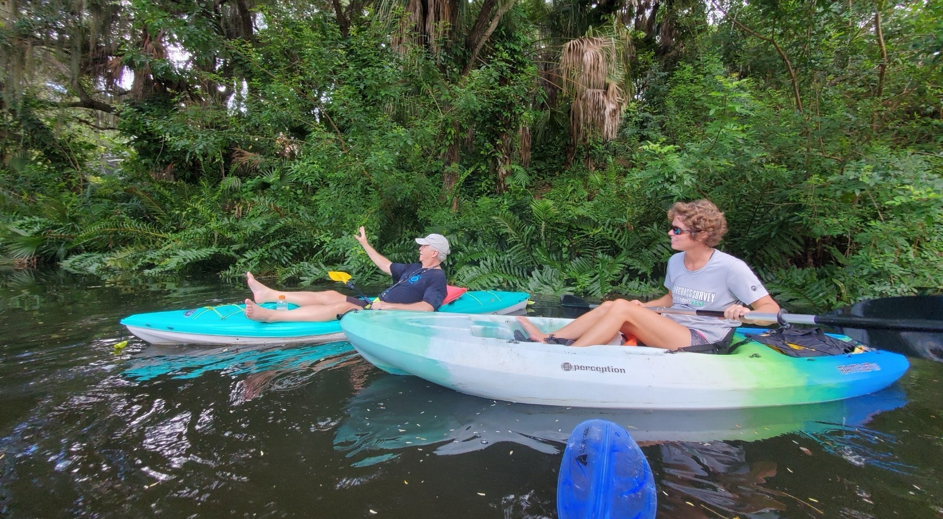
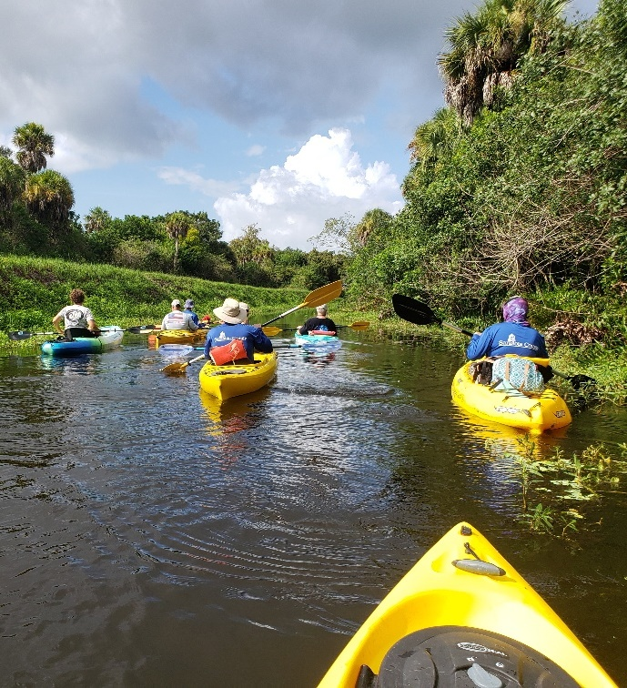
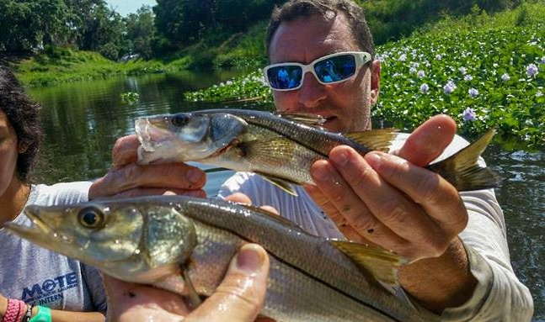
Alligator Creek Stream Restoration
Project Vision
Notes:
Sarasota County is very excited about the Alligator Creek Stream Restoration project. We see this project as a holistic approach to remedying multiple environmental issues. Projects like Alligator Creek allow us transcend the historic norms and foster a solution that not only conveys water but also environmentally makes sense. The features of this project will lend opportunity to bring the public in close to our work and see the benefits for themselves.

Slide 20

Alligator Creek Stream Restoration
Questions or Comments?

